Slide 1

Space Patrol
Developed by: Roberto Ito & Yayun Yang

Slide 2
Roles
Roberto Ito
Designer
Developer
QA Tester
Yayun Yang
Designer
Developer
QA Tester

Slide 3
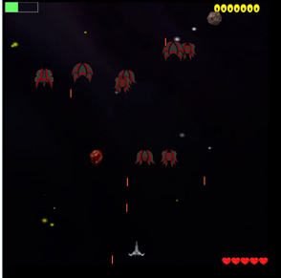
Game Interface

Slide 4
Overview
Top down shooter game with space background
Difference weapon types, enemies, obstacles, and collectibles

Slide 5
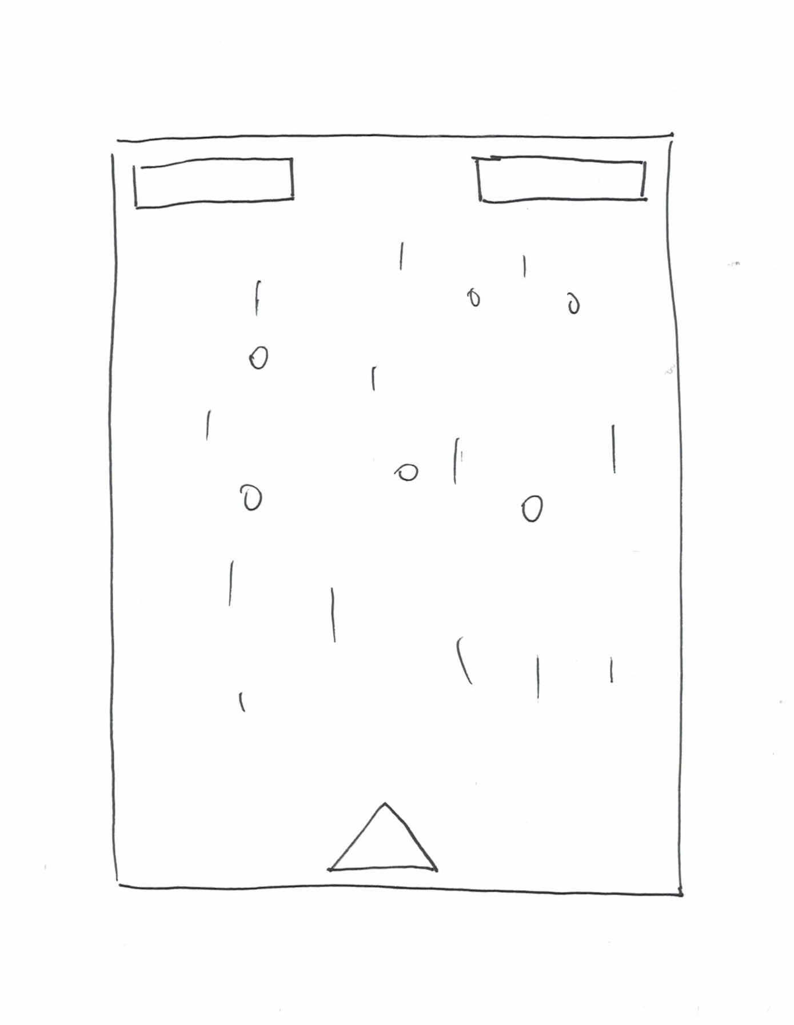
Planning

Slide 6
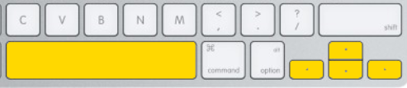
Instruction
Controls of our game
Scoring
4 types of enemies - 10, 20, 30, 40
2 types of meteors - 5, 10
3 bosses - 1000, 2000, 3000

Slide 7
Lessons Learned
CreateJS
State designing
Movement designing

Slide 8
Future Possibilities
Weapon extension
Cheat code

Slide 9
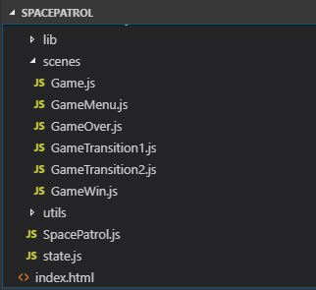
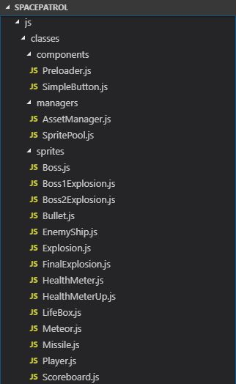
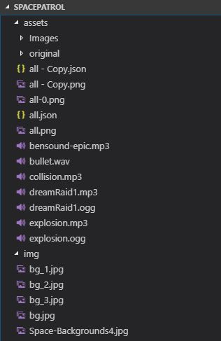
Code structure and organization

Slide 10
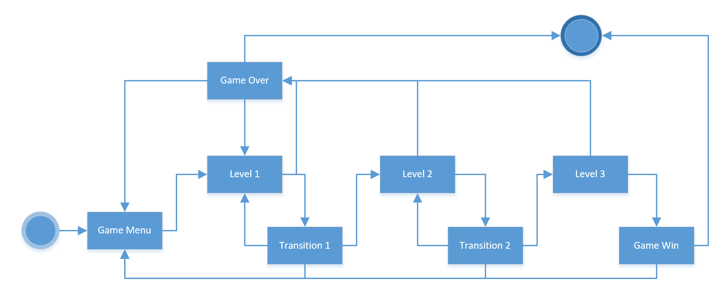
State Diagram

Slide 11
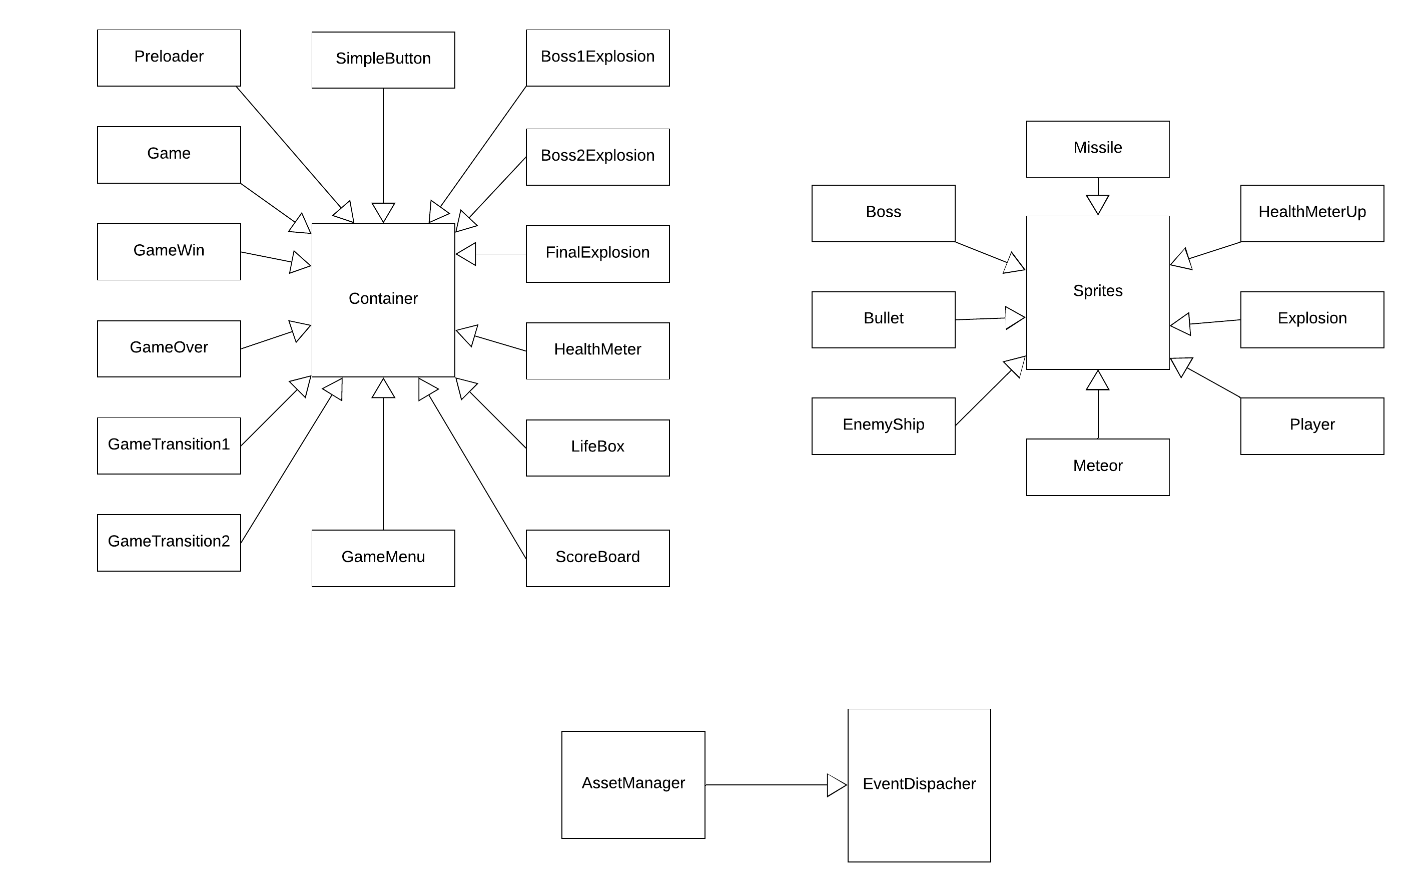
Class Diagram

Slide 12
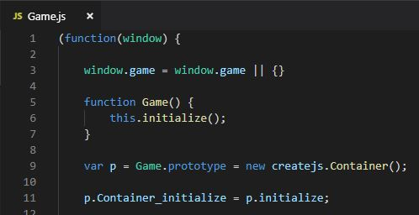
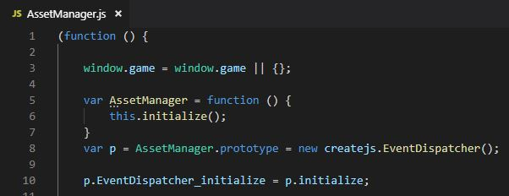
Classes
Container
Methods:
addChild
dispatchEvent
getBounds
getChildAt
removeChild
Properties:
x
y
EventDispatcher
Methods:
dispatchEvent

Slide 13
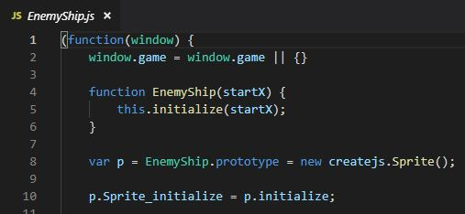
Classes
Sprite
Methods:
dispatchEvent
getBounds
gotoAndPlay
gotoAndStop
on
stop
Properties:
alpha
paused
regX
regY
x
y

Slide 14
Game link
https://robertoito.github.io/SP_FB/

